Slide 1


Finding demand for taxi by region using SNS
Team 8
17102063 Lee, Yoo Seok
17102060 Lee, Seong Hun
17102069 Hwang, Dong Gyu
19102092 Seo, Hyeon Yeong

Slide 2
Table of Contents
Overview & Background
Goal of our project
Structure of our service
Data Processing
Code Review
User Interface
Benefit
Notes:
Need to revised

Slide 3


O verview & Background
Taxi drivers
Perspective of Taxi passengers
Where is the taxi stand that many passengers are at?
Notes:
In these days, many of applications for taxi passengers are rapidly being developed. In those applications, the passengers use taxis by calling them.
We reversed the perspective of users of app, focusing on the Perspective of taxi drivers.
Most of taxi drivers need the answer to this question. “Where is the taxi stand that many passengers are at?”
And we decided to create a web service for that.

Slide 4
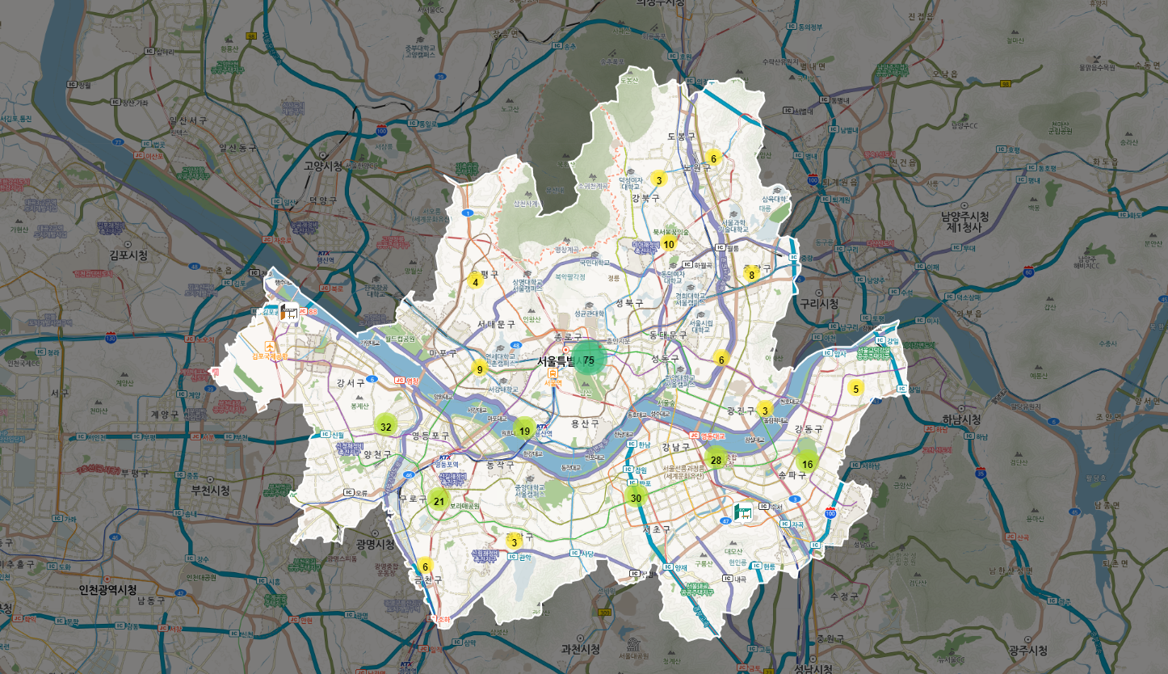
Notes:
Recently, a policy to install taxi stands has been promoted, but it is pointed out that the actual use rate is low.
There are 422 of taxi stands in Seoul,
애니메이션 실행 후 그래프 띄우기
and government decided to transfer and demolish 42% of them, which will result in 44% of financial loss.
Some experts analyzed this problem occurs because the initial demand for taxi at those locations are estimated not properly.
So we came up with the idea that associating the location of taxi stands data and popular sites data in Seoul by using SNS.

Slide 5
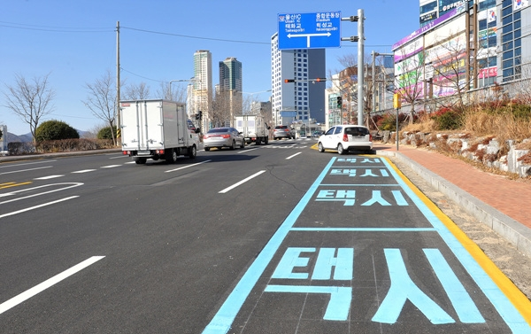








In densely populated area
In sparsely populated area
The Need for Taxi Stand
Notes:
Then let me explain the reason why we used location of taxi stands data.
When taxi stand is located in densely populated area, usage of taxi is high. But when taxi stand is located in sparsely populated area, usage rate is really low.
Later, in order to improve the use of taxi stands, It is necessary to install a taxi stand at a point where there are a lot of passengers.
In these days, mobile services such as 카카오t and t map taxi are getting popularity. And naturally, someone can think that taxi stands are no longer needed.
애니메이션 두개 따당
But, taxi stands are necessary. Because it can be a taxi drivers’ place for rest. Also, without taxi stands, taxi drivers should move around with an empty car. That results in increasing congestion and car fuel waste.

Slide 6



Goal of this project
Finding a relationship
between the location of taxi stands data
and SNS location data
Getting location of
taxi stands data
Extract data from Instagram
Create a web service showing the location of the taxi stands and the population density according to the user’s location !
Notes:
Let me explain our goal of this project. Firstly, we will get the data set about location of taxi stands in Seoul. Considering that the cause of the low use of taxi stands is a problem of location, we spatially analyzed taxi rides and compared them with the location of taxi stands.
Next, we will extract data from SNS by using crawling. Here, we specified SNS as a Instagram. Lots of mobility service companies are using SNS data when they predict demand with big data analysis.
After gathering these data sets, our goal for analysis is to find a relationship between them.
Finally, we will create a web service providing useful information of locations with taxi stands and the population density according to the user’s current location.

Slide 7










Structure of our service
AWS
Taxi Stands
Data
Apache2
Server
Fetch-app
Post Location
& Time
refine-app
Sqoop
Impala
HDFS
Web Crawler
analysis-app
Notes:
Here is the structure of our service.
First, we extracted the location and time of the Insta post through web crawling, stored it in HDFS, and processed the data using the KAKAO map API and Impala.
The longitude and latitude of each post location data were extracted through the KAKAO map API, and the entire area of ​​Seoul was divided into 100,000 Section_ID in advance through impala and a Section_ID was assigned to each post.
The processed data was fetched to MySQL using Sqoop.
Next, the latitude and longitude were extracted from the taxi stations data search using the KAKAO map API and fetched in MySQL.
After that, by linking the php module and the apache 2 server in the amazon web server , the data in MySQL was provided to the dashboard HTML file.

Slide 8
Data Processing

Slide 9

Getting the locations of taxi stations data
Search the locations of taxi stands in Seoul from the public map site (https://map.seoul.go.kr/smgis2/seoulMap).
2. Extract the location data from the text file.
3. Convert the location data into the data with latitude and longitude.
4. Load the data into the server.
Notes:
Then let me explain the steps for data processing.
First, getting the locations of taxi stands data.
Actually it was hard to find the clear data set of locations, so we searched it from public Seoul map site.
Using crawling, we extracted the text data from the map site and converted the location data into the data with latitude and longitude.
Finally the data set is loaded into the server.

Slide 10



Extract the location data from Instagram posting
Crawler
Post queue
District data in Seoul
…
{
date,
time,
tags,
place
}
extract
Posts tagged with popular cafes and restaurants
[Tag of date, time, location, …]
Notes:
Next extract the location data from instagram posting.
We searched the post based on the district data in seoul. And in those posts tagged with popular cafes and restaurants, date time and location data are extracted by crawling. And then, it is loaded into hdfs.

Slide 11


Analyze the relationship between location data of SNS and taxi stands.
Locations of taxi
stands in Seoul
Number of posts uploaded in a specific time and location
Location of Taxi Stands
(latitude, longitude)
Tagged location in post
(converted in latitude, longitude)
201X. XX. XX 00:00
Expecting demands of taxi passengers
Notes:
After gather the data, analyze the relationship between locations data of taxi stand in Seoul and the number of posts uploaded in a specific time and location.

Slide 12
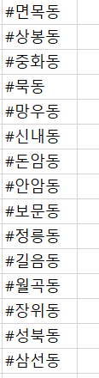
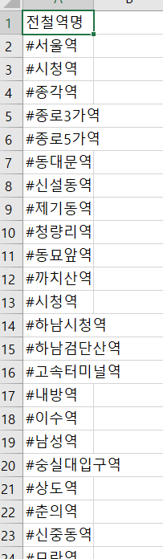
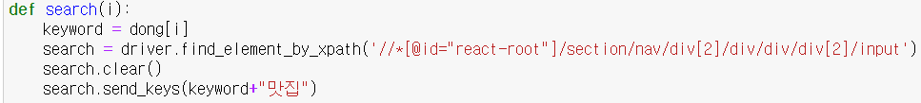
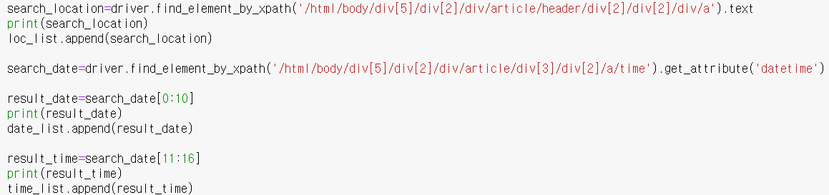
Crawler post from Insta
Tag Keyword
→ Search Tag Keyword
→ Get Location
→ Get Date
→ Get Time
Notes:
We performed a search on Instagram by attaching restaurants and cafes to data from 297 stations and 165 dong addresses to obtain location/date/time data for each searched post.

Slide 13
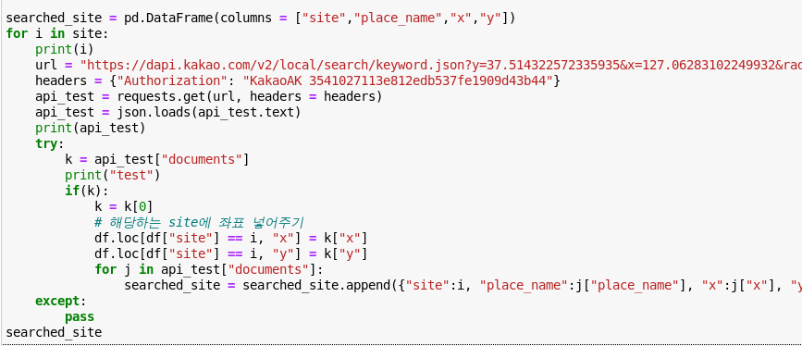
Extract latitude, longitude from Insta Post
Get each
latitude, longitude
from using Kakao map API
→ Get latitude, longititude
Notes:
The longitude and latitude of each post data obtained from crawling were extracted using the Kakao Map API.

Slide 14
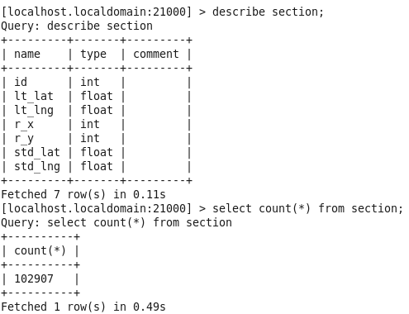
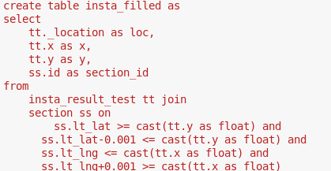
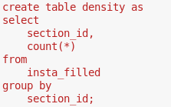
Refine Data using Impala
Assign each post to its section
Divide the entire Seoul area into 100,000 units based on latitude/longitude
Counting number of posts for each section
→MySql
Notes:
By using Impala, The extracted latitude / longitude data was allocated to the Seoul section data, which was divided into 100,000 sections in Seoul, which had been made in advance. After that, we counted the number of posts for each section to check how much population is concentrated in the area.

Slide 15
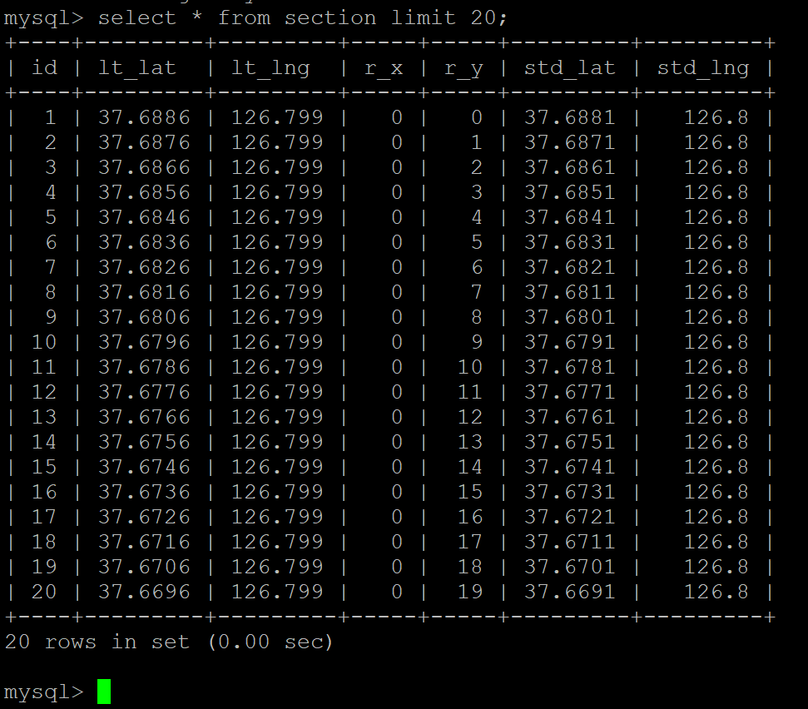
Divide Seoul district detail
Section
id //unique id (auto increase)
lt_lat,lt_lng //left top point of unit. Each unit has width, height of 0.001(100m)
r_x,r_y //relational position which is from (0,0) to (426,240)
std_lat, std_lng //center point of each unit. The marker will be located at this.
Notes:
in detail, we made a section table that divides Seoul into 100m intervals.
Latitude and longitude 0.001 are the actual 100m distance.
lt_lat, lt_lng, represents the coordinates of the left top point of each section which has 100m width and height.
Relative xy is the relative position of each section from (0,0) to (426,240). This is used for partial loading.
The standard lat,lng are the center points of each section. Information about the sections that appear on the map will be located at this point.

Slide 16
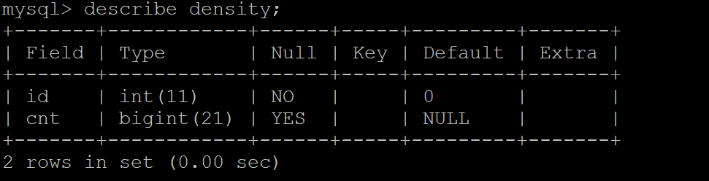
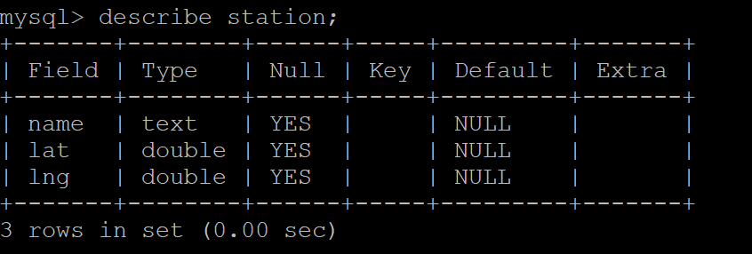
Table scheme (in MySQL)
density(id // section id, cnt //the number of posts mentioned)
station(lat,lng) // information of taxi station
Notes:
The database accessed by the Web server consists of two tables. The density table contains information on the number of mentioned posts per section after processed in Hadoop. The station table has information on the latitude and longitude of the taxi stand.

Slide 17
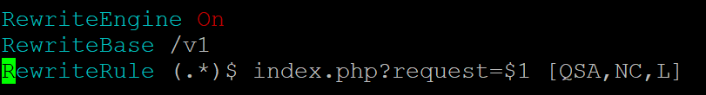
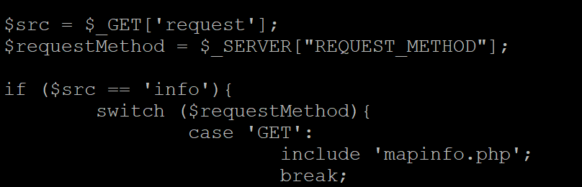
Server Functions Interface
Base url : https://t8n5.site/v1/
Rewrite the request url to index.php and resource location to parameters
So, the index.php can route each functions.
Notes:
Based on these databases, the server provides the http function, which allows index.php to route the locations of various resources by modifying the rewrite rule of .htaccess.
Also, using RewriteBase, the base url of the api is placed under v1/. This can change the location of resources at once when the api version is updated later.

Slide 18
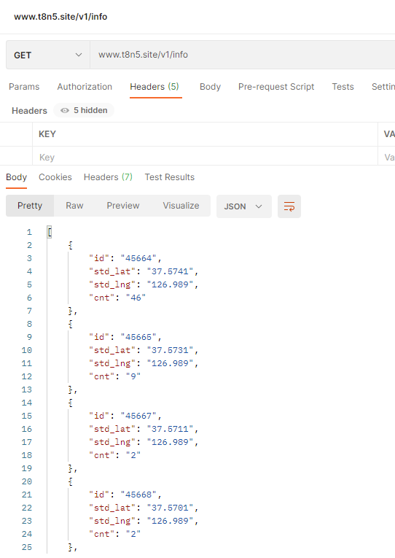
Server Functions Interface
url : /v1/info
Method : GET
Parameter :
latitude (default 37.570865) //my latitude
longitude (default 126.997938) //my longitude
degree (default 10) //relative coordinate radius to load
Result(JSON) :
array of
std_lat, std_lng, cnt // Number of posts
mentioned in the section.
Notes:
The first api routed from index.php is info, which requests information on the surrounding sections where the mentioned posts exists.
If passing the latitude, longitude, and radius degree of my position as parameters, it returns array of standard location of the sections and the number of posts mentioned.
The figure on the right is an example method call using Postman.

Slide 19
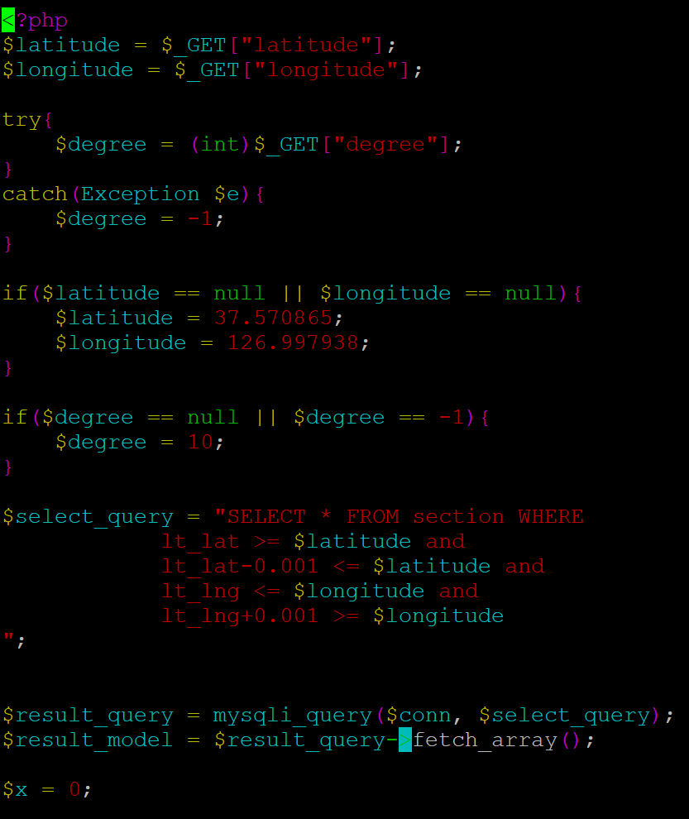
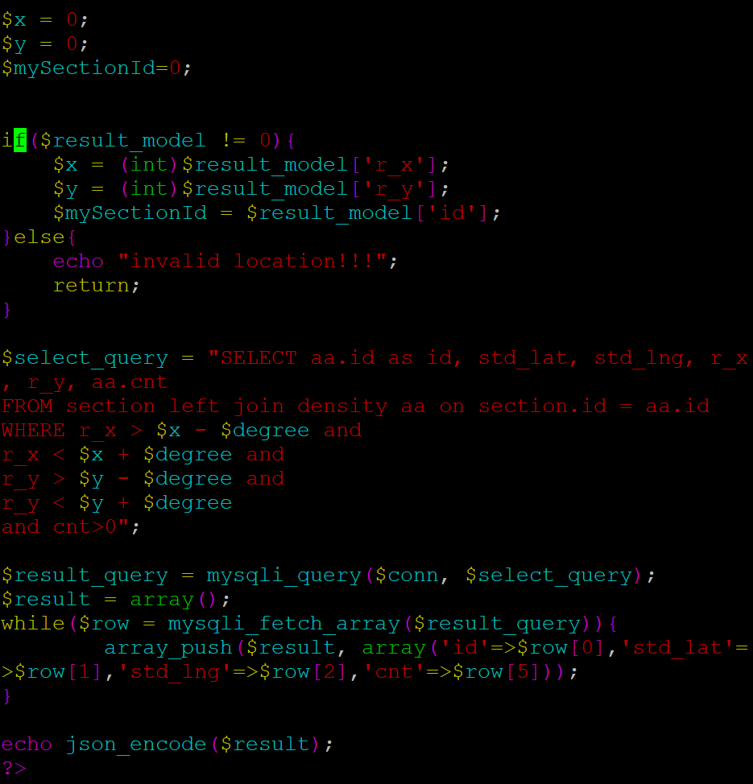
Implement of API using php
Notes:
This is an info method implemented by php.
First, search for the section id that I belong to with my location that I received as a parameter.
Then, get the number of posts for sections whose Manhattan distance is less than or equal to degree.
Finally, it return the result in json form.

Slide 20
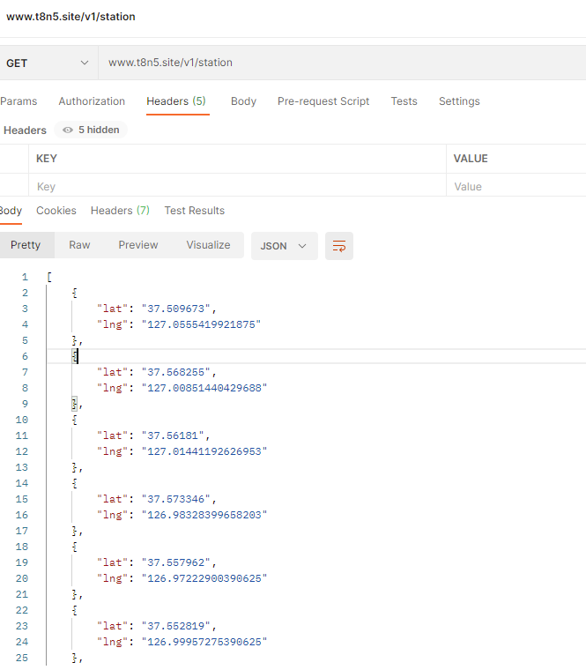
Server Functions Interface
Example of method call
url : /v1/station
Method : GET
no Parameter
Result(JSON) :
array of lat, lng //position of taxi stations
Notes:
The second api is station, which requests information on all taxi stands.
Each taxi stand has latitude and longitude information.
The figure on the right is an example method call using Postman.

Slide 21
Front-end development
Function
Search Address
geoCode (Latitude, Longitude) to Address
Address to geoCode(Latitude, Longitude)
Get user’s GPS Information
Represents
Make and show Nodes given from JSON Result Data (Posts, Taxi Station)
Show current GPS Location
Map Movement to current GPS Location
Notes:
The second api is station, which requests information on all taxi stands.
Each taxi stand has latitude and longitude information.
The figure on the right is an example method call using Postman.

Slide 22
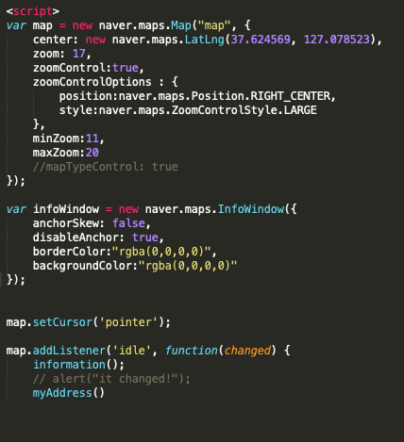
Front-end development
Notes:
The second api is station, which requests information on all taxi stands.
Each taxi stand has latitude and longitude information.
The figure on the right is an example method call using Postman.

Slide 23
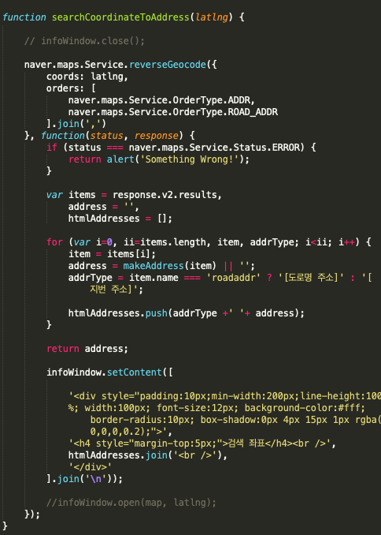
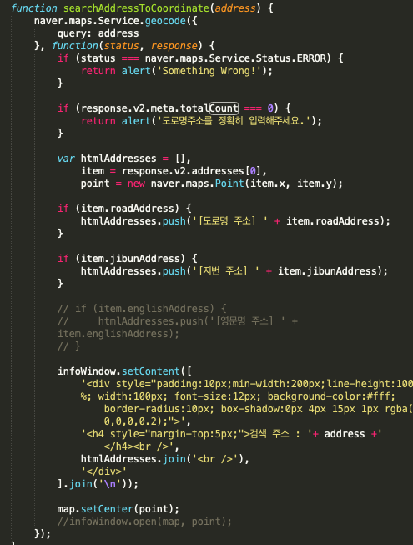
Front-end development
Function
Search Address
geoCode (Latitude, Longitude) to Address
Address to geoCode(Latitude, Longitude)
Get user’s GPS Information
*Important
Map -> center location Data
Notes:
The second api is station, which requests information on all taxi stands.
Each taxi stand has latitude and longitude information.
The figure on the right is an example method call using Postman.

Slide 24
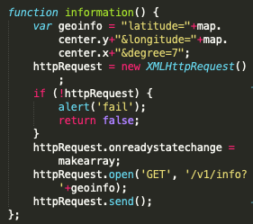
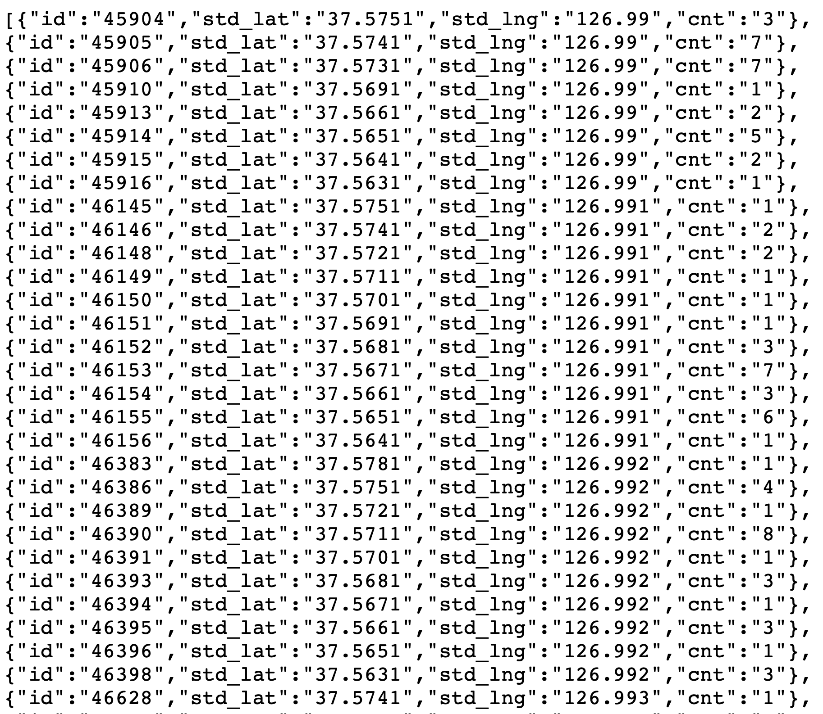
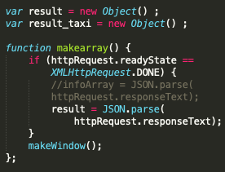
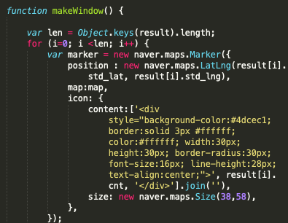
Front-end development
Represents
Make and show Nodes given from JSON Result Data (Posts, Taxi Station)
Get JSON data using Ajax
Get the Data
Make it to Array
Make as many nodes as server has
Given to Display on map
Notes:
The second api is station, which requests information on all taxi stands.
Each taxi stand has latitude and longitude information.
The figure on the right is an example method call using Postman.

Slide 25
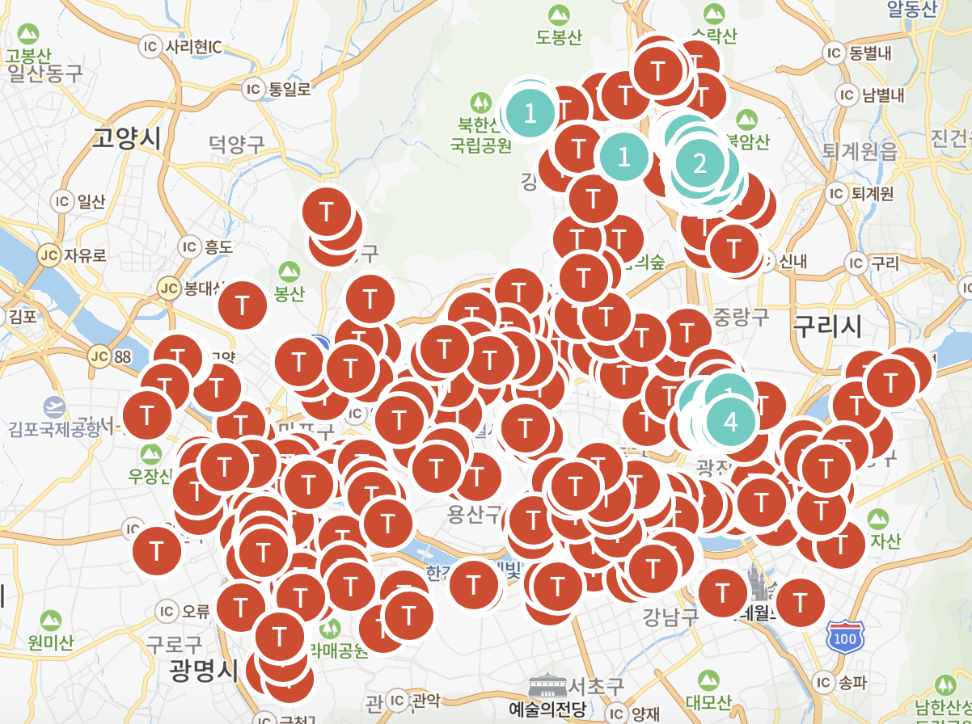
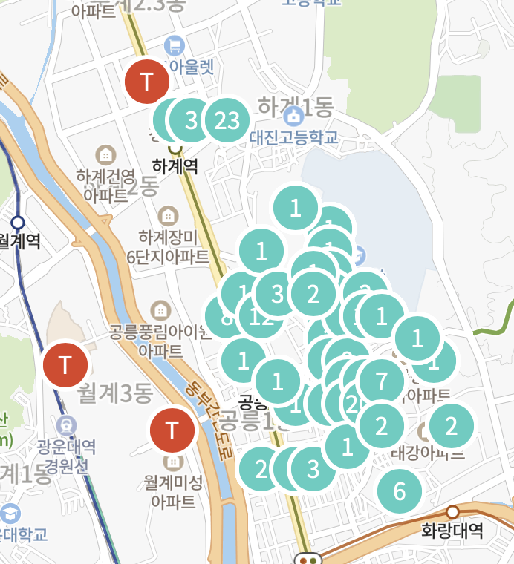
Front-end development
Represents
Posts Nodes
Taxi Nodes
Call by specifying Area
Give Lat, Lng to Server
Server gives data includes in surrounding data
So when Reference Coordinates changed,
send request to server again.
Since It have 260 data, Request whole data.
And make whole Nodes to represent.
Notes:
The second api is station, which requests information on all taxi stands.
Each taxi stand has latitude and longitude information.
The figure on the right is an example method call using Postman.

Slide 26
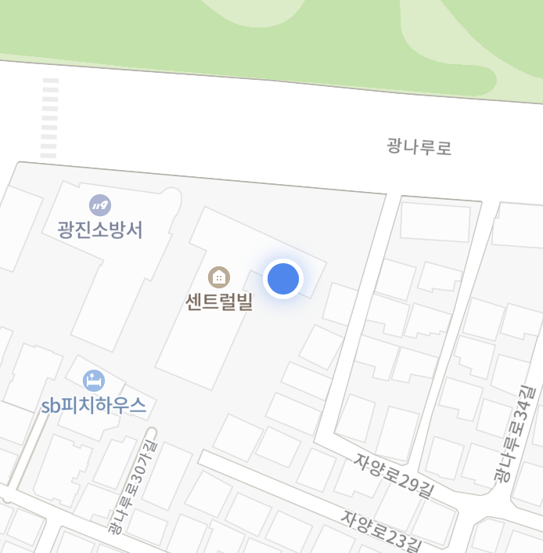
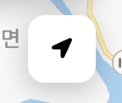
Front-end development
Represents
Show current GPS Location
Map Movement to current GPS Location
Notes:
The second api is station, which requests information on all taxi stands.
Each taxi stand has latitude and longitude information.
The figure on the right is an example method call using Postman.

Slide 27
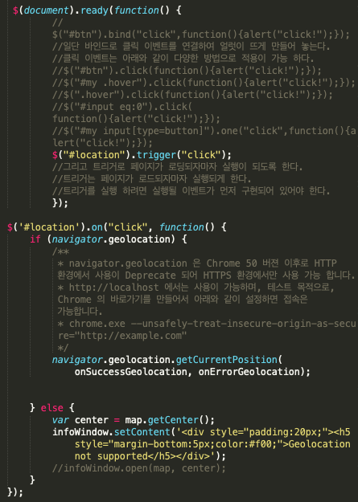
Front-end development
Represents
Show current GPS Location
Map Movement to current GPS Location
Move to current location on first connection
onClick Function
Notes:
The second api is station, which requests information on all taxi stands.
Each taxi stand has latitude and longitude information.
The figure on the right is an example method call using Postman.

Slide 28
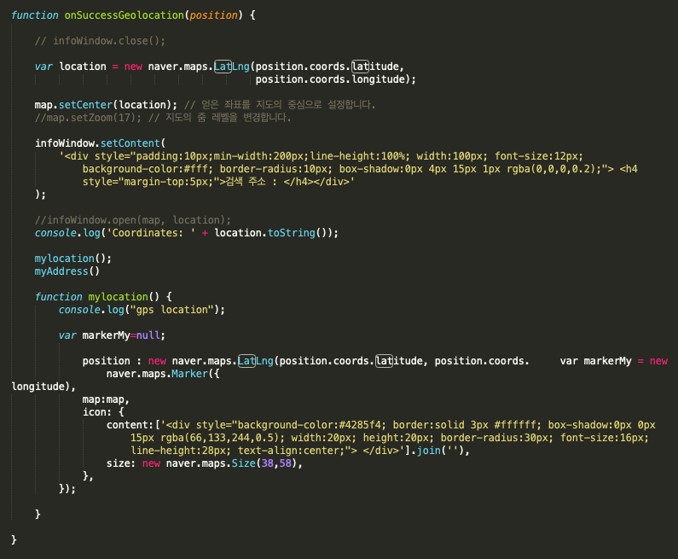
Front-end development
Represents
Show current GPS Location
Map Movement to current GPS Location
Imported current location from Naver API
Adjust the map so that the current position is centered
Create markers to display on a map
Notes:
The second api is station, which requests information on all taxi stands.
Each taxi stand has latitude and longitude information.
The figure on the right is an example method call using Postman.

Slide 29
Final Result
ServiceLink

Slide 30
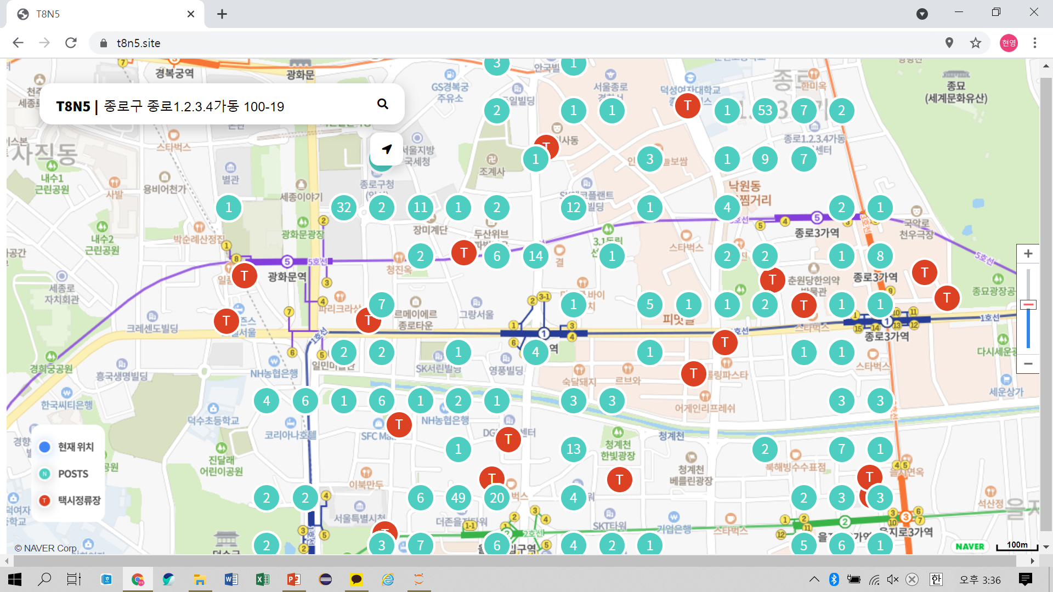
User Interface
Searching Box (able to change according to user’s current location)
*Input address should be specific*
Post
location
T
Taxi
stands
Notes:
This is the user interface. At left above, you can see the search box that can be changed according to the user’s current location. And on the map, mint circles represent the Instagram post locations and the red circles are representing spots of taxi stands. Nearby the 종각 station, you can see the population density is relatively high and the location of taxi stands are quite close with the densely populated sites.

Slide 31
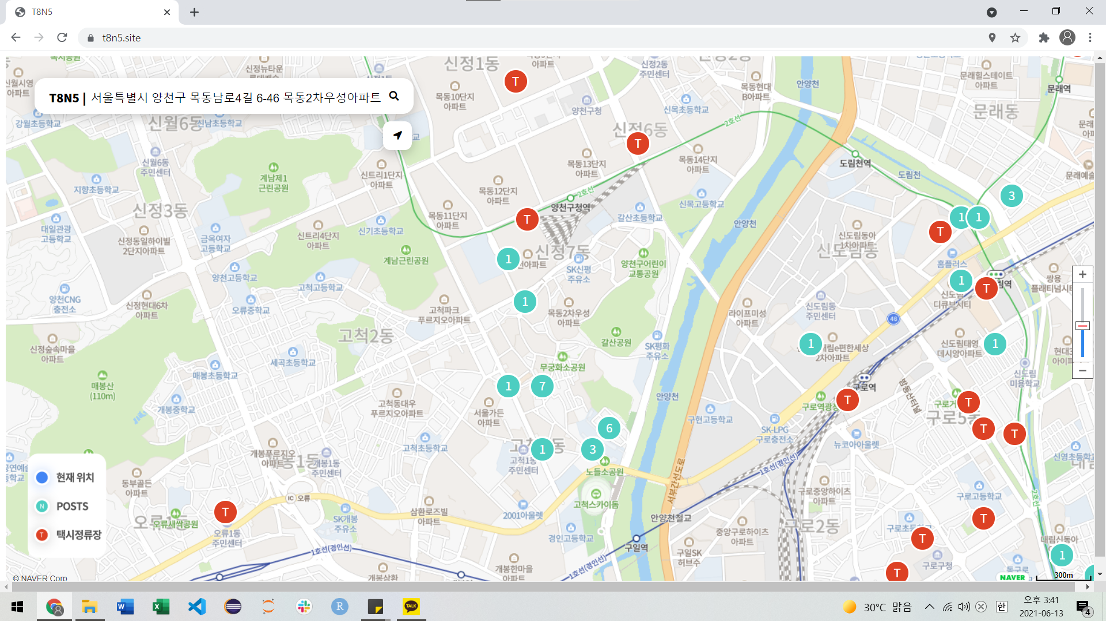
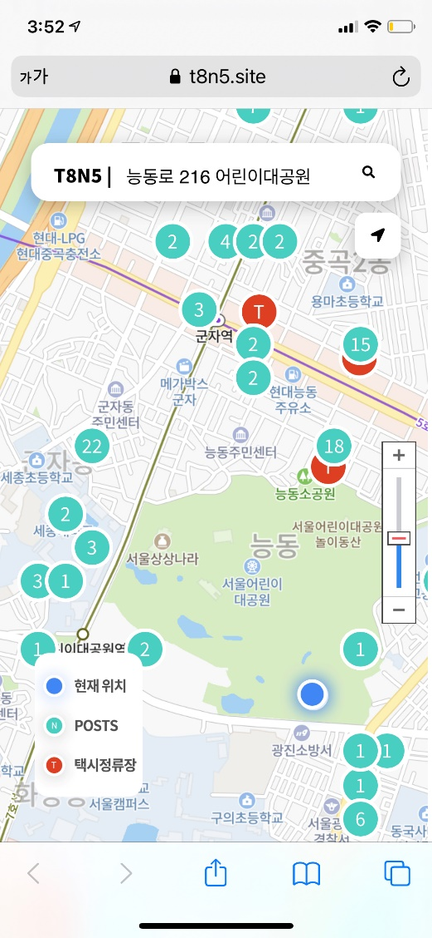
User Interface
Notes:
However, as we mentioned in the overview, we could find the problematic locations of taxi stands. For example, In 양천구, there are a few of taxi stands left side, but population density in that area is not so high compared to the previous slide case. Then, we can say this is the target region for transferring or removing the taxi stands.

Slide 32




Benefits of our service
Improve taxi drivers’ profit & convenience
Efficient transportation policy, increased public convenience
Faster taxi ride available
at night time
Useful resource for basis data of various taxi service
Notes:
Here are the benefits of our service.
Firstly, it provides useful information of locations with many passengers for improving taxi drivers’ profit and convenience.
Second, by improving usage of taxi stands, it can increase efficiency of government’s transportation policy and public convenience.
Third, it can be a useful service for both drivers and passengers. Especially, in late night, buses and subways are closed. Then taxis are the only possible public transportation at night. So fast communication can be achieved.
Lastly, for developing new software related to this kind of service, data we utilized in our service can be the great base.

Slide 33
Thank You TeamWork makes the DreamWorks
-We are Team8

